Slide 1
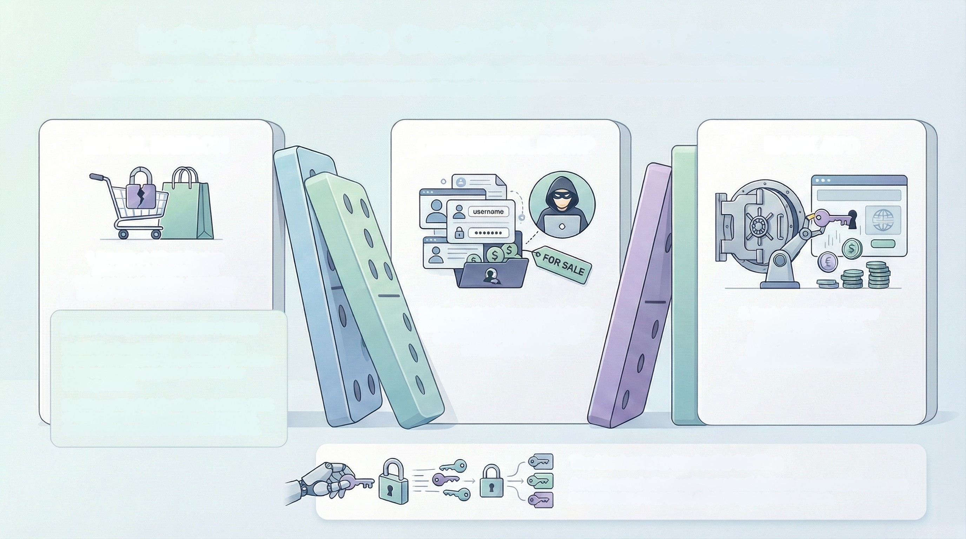
Indirect Risk: The Credential Stuffing Contagion
Our bank's risk exposure is no longer confined to our own walls. Breaches in seemingly unrelated client sectors provide the raw
materials-credentials and personal data-that attackers use to directly target our customers' bank accounts, creating a domino effect of risk.
RETAIL BREACH
CREDENTIAL DUMP
BANK ATO
1. Breach at Client Sector:
Attackers compromise a
third-party company, such as a
retailer or healthcare provider.
2. Credentials Harvested & Sold:
Stolen usernames and passwords
are collected and often sold
on the dark web.
3. Bank Account Takeover
(ATO): Criminals use
automated tools to test
these stolen credentials
against our banking portal.
Sector Analysis: The Fuel for Attacks
Retail: The Source of 'Dirty' Credentials:
Groups like Scattered Spider target UK retailers
to harvest loyalty program passwords for
banking attacks.
Healthcare: The Full Identity Kit: In 2025, 100%
of hacked health records were unencrypted,
exposing data needed to reset banking PINs.
The Mechanism: Credential Stufing
An automated attack using credentials from one breach to access
accounts on other sites, exploiting password reuse.

Slide 2
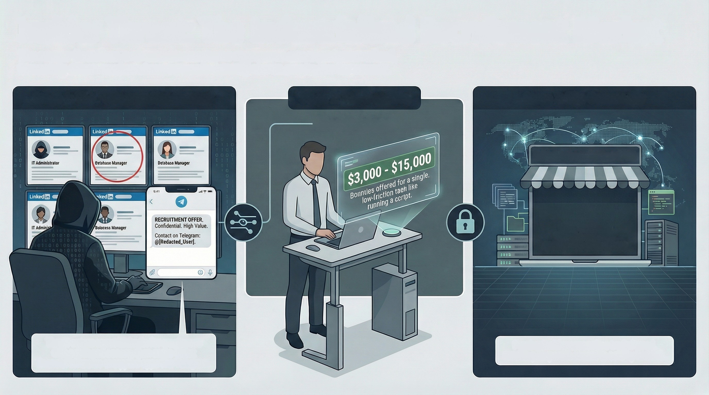
Insider Threat: The Industrialized Recruitment Market
The insider threat has evolved from employee negligence into a professionalized,
financially-driven market where criminals actively recruit employees for access.
Stage 1: The "Telegram Headhunter"
Stage 2: The Incentive
Stage 3: The Commodity
Marketplace
Initial Access Broker (IAB)
OVER 3,013
COMPROMISED
"INITIAL ACCESS"
INSTANCES SOLD (2025)
Threat actors scout LinkedIn for employees
with privileged access, then make direct
financial offers on encrypted apps like Telegram.
Proving insider access is a traded good,
resulting corporate access is sold by brokers.

Slide 3
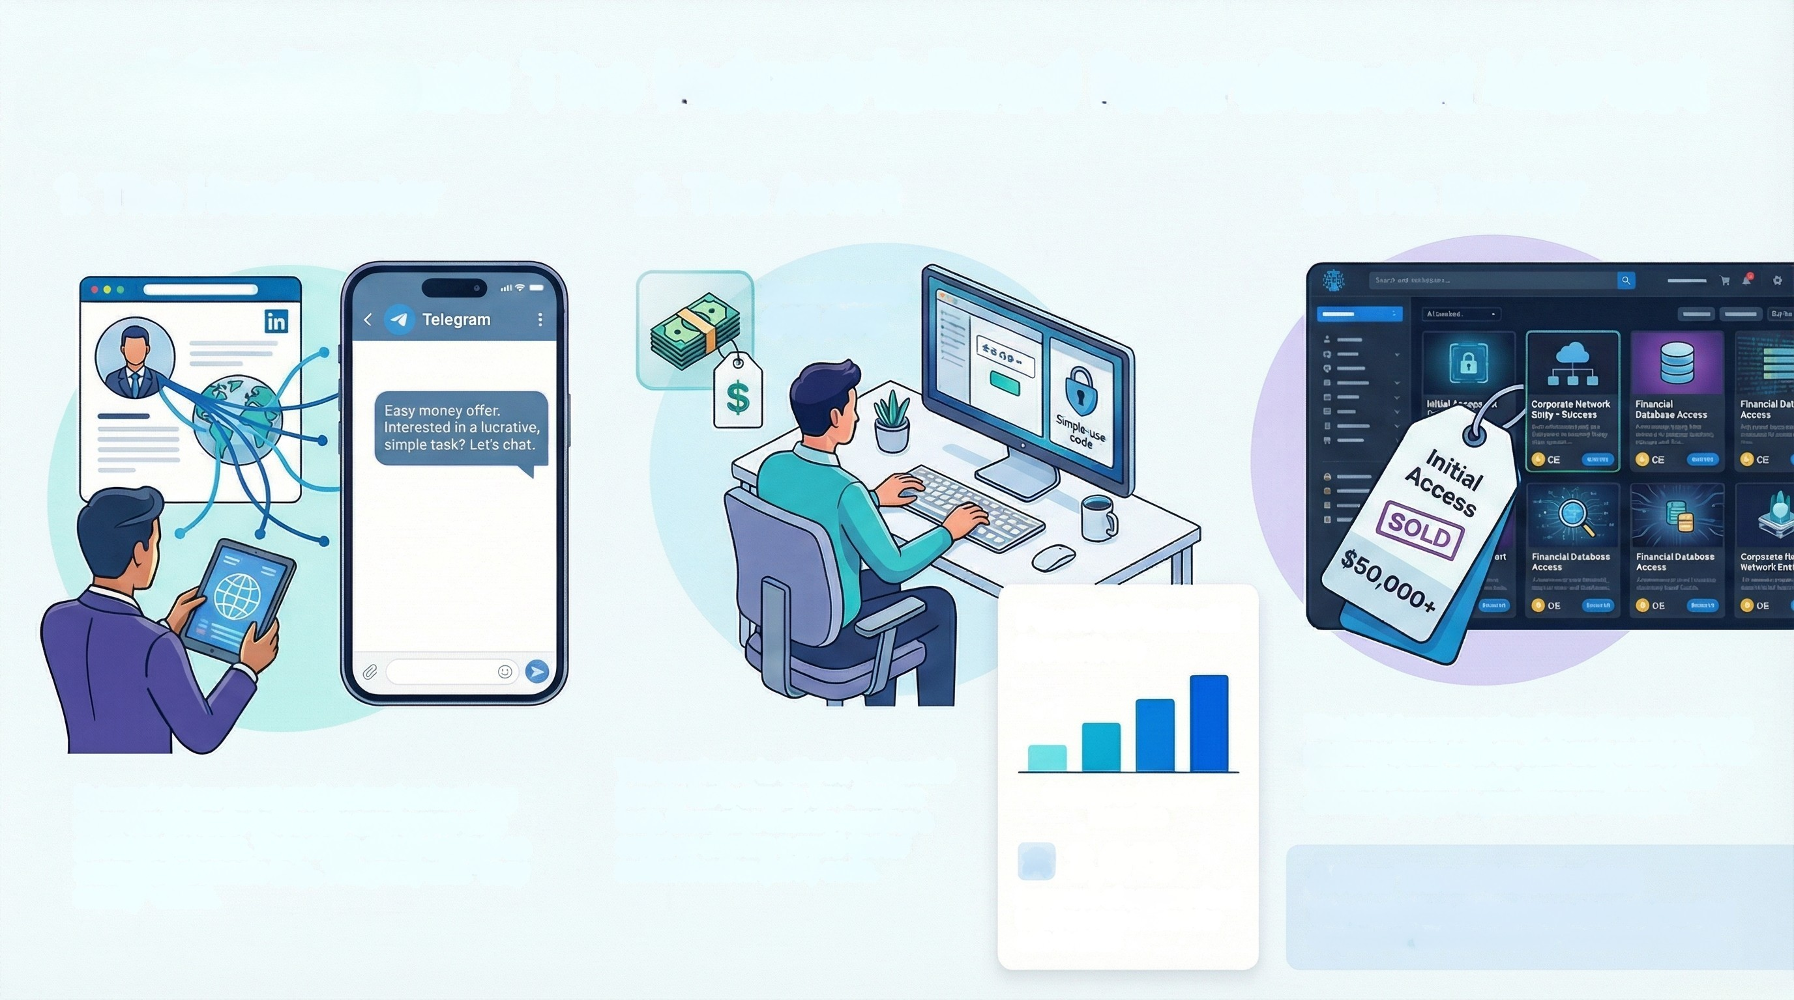
Insider Threat: The Industrialized Recruitment Market
1. The Headhunter
2. The Asset
3. The Broker
Financial Bounty:
$15,000
Powerful Financial
Incentives
The initial access gained from the employee is
packaged and sold on dark web markets. This
access is treated as a commodity for other
criminal groups to purchase and exploit.
The employee is offered a financial
bounty for a simple, low-friction
task. Examples include running a
script or sharing a multi-factor
authentication (MFA) code.
External actors scout professional networking
sites like Linkedin to identify employees with
privileged access. They make direct contact on
encrypted channels (e.g., Telegram) with "easy
money" offers.
$3,000 to $15,000
Bounties
& 3,013
instances of compromised
initial access offered for
sale in 2025
A New Threat Mechanism:
The model has shifted from the "disgruntled
employee" to the actively "recruited asset".

